Slide 1
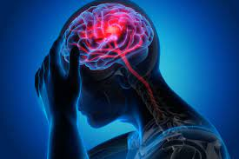
2022 Stroke Predictions Case Study
Created BY: Najah Swann

Slide 2
The Context
Background
Context
Context #2
According to the World Health Organization (WHO) stroke is the 2nd leading cause of death globally, responsible for approximately 11% of total deaths.
They have given me data to clean, explore, and analyze to create a presentation for a technical audience that describes trends in this Stroke Data related to Prediction.
This dataset is used to predict whether a patient is likely to get stroke based on the input parameters like gender, age, various diseases, and smoking status. Each row in the data provides relavant information about the patient.

Slide 3
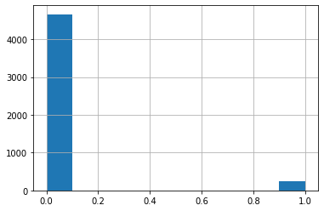
First Insight With Supporting Visual
# of Paitents
Stoke
0=NO
1 =Yes

Slide 4
This HIstogram indicates that in this dataset majority of the paitents that surveyed never had a stroke

Slide 5
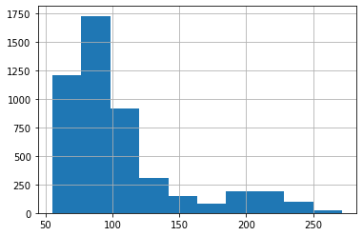
Second Insight With Supporting Visual
# of Paitents
Glucose Levels

Slide 6
This HIstogram indicates that in this dataset majority of the patients that surveyed had average glucose levels
Keep in mind that average glucose levels are under 140

Slide 7
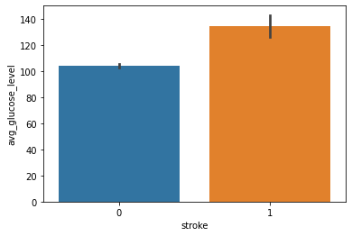
Third Insight With Supporting Visual

Slide 8
This bar graph indicates that in this dataset most people that have strokes have a higher glucose levels than people who don’t have strokes
Keep in mind that average glucose levels are under 140

Slide 9
The Model I Decided To Use
The Model I decided to use was the Decision Tree Model.
What is a decision tree you ask ?
A Decision Tree is a simple representation for classifying examples. It is a Supervised Machine Learning used for classification and regression. The goal is to create a model that predicts the value of a target variable by learning simple decision rules inferred from the data features

Slide 10
The Metrics I Decided To Use
The Metric I decided to use was the f1 score .
What is a f1 score you ask ?
A f1 score is a popular performance measure for classification and often preferred over when accuracy when data is unbalanced. It is also a way to combine precision and recall as one metric

Slide 11
Evaluation of Model
When i did the f1 Score i got 92.3%
Meaning overall my model is performing well

Slide 12
Conclusion

Slide 13
To Conclude
Majority of Patients did not have a stroke
Majority of patients had average glucose levels
See the connection?
It only makes sense that we can see how average glucose levels and strokes correlate to each other
The graph shows that majority of the patients hadn't had a stroke in their lifetime
The other graph shows that majority of the patients had a glucose level lower than 140
In all actuality if you have a high glucose level, chances are you more likely to have a stroke

Slide 14
